Slide 1
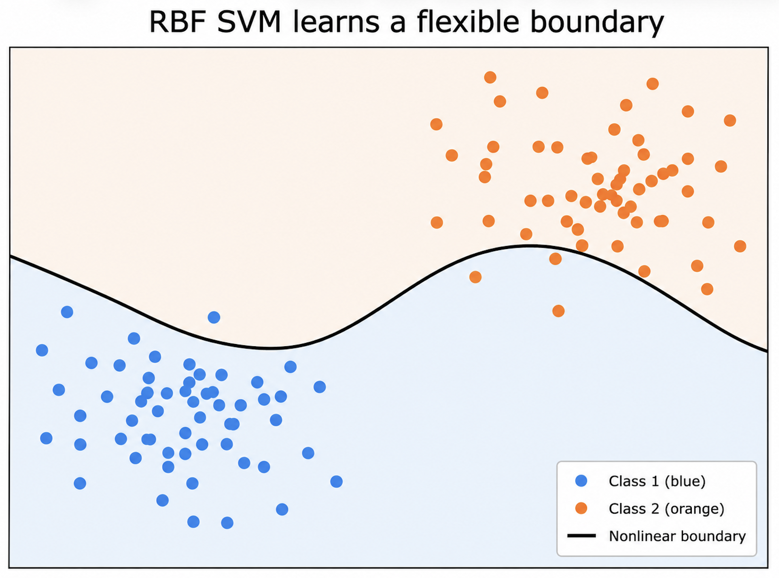
Soft-Margin SVMs and the Penalty Parameter C
A brief algorithm tutorial using Parkinson’s voice classification as the example
Maximum
margin
Soft-margin
classification
Penalty
parameter C
RBF
kernel
Kathryn Reid
DataSci 224 Final Project
1
Notes:
Today I’m going to explain soft-margin support vector machines, with a particular focus on the penalty parameter C.
I’ll use Parkinson’s voice classification as the example application, but the main aim is to explain the algorithm rather than the dataset.
The key idea is that real data are rarely perfectly separable. In biomedical datasets, groups often overlap because measurements are noisy, patients vary, and features do not always cleanly separate disease from control. So rather than forcing perfect classification, a soft-margin SVM allows some mistakes, and the parameter C controls how strict or forgiving the model is.

Slide 2
1. What problem does an SVM solve?
DataSci 224 Final Project
SVMs are supervised classifiers: they learn a boundary that separates two labelled groups.
Biomedical voice
features
SVM decision
boundary
Predicted disease
status
For this project, the labels are status = 0 healthy and status = 1 Parkinson’s.
The dataset is useful for illustration because voice features are continuous and overlapping, which makes the classification boundary non-trivial.
SVM asks: where should the boundary go?
binary labels
healthy vs Parkinson’s
Kathryn Reid
2
Notes:
An SVM is a supervised classification algorithm. It learns from labelled examples and tries to find a boundary that separates two groups.
In this example, the inputs are continuous biomedical voice features, and the output is binary disease status: healthy control or Parkinson’s.
So the question for the SVM is: where should the decision boundary go?
This is not always obvious, especially when the features overlap. Some healthy controls may have voice measurements that look similar to Parkinson’s recordings, and some Parkinson’s recordings may look closer to controls. That overlap is exactly why soft-margin classification becomes important.

Slide 3
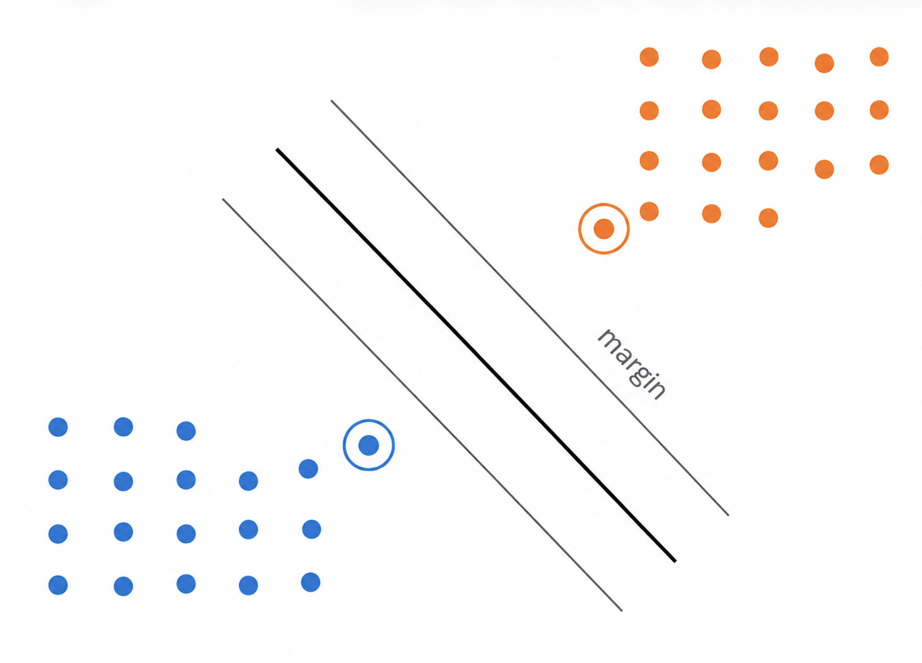
2. The maximum-margin idea
DataSci 224 Final Project
Among possible separating boundaries, SVM chooses the one with the widest margin.
Decision boundary
The central line separates the predicted classes.
margin
Support vectors
Only the closest points determine the margin and therefore shape the boundary.
Kathryn Reid
3
Notes:
The starting idea behind an SVM is the maximum-margin principle.
If several boundaries could separate the classes, the SVM chooses the one with the widest margin. The margin is the gap between the decision boundary and the closest training points from each class.
Those closest points are called support vectors, and they are important because they directly shape the boundary.
A wider margin is useful because it usually gives a simpler and more stable classifier. But this maximum-margin idea works best when the classes are cleanly separable. In real biomedical data, that is often unrealistic, which leads to the soft-margin version.

Slide 4
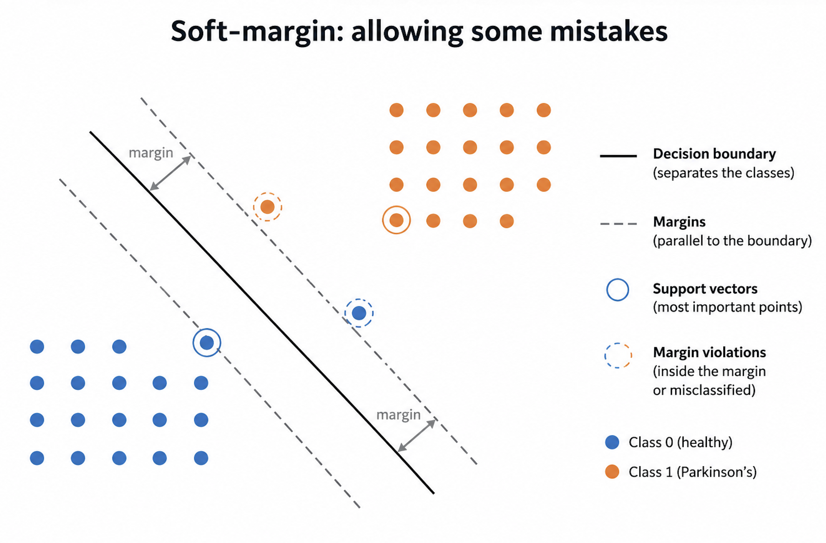
3. Soft-margin classification: real data overlap
DataSci 224 Final Project
Perfect separation is often unrealistic. Soft-margin SVM allows some violations of the margin.
Hard margin
Requires all training points to be correctly separated. Usually too strict for noisy biomedical data.
margin violations
Soft margin
Allows some points inside the margin or on the wrong side, while still trying to keep the margin wide.
Kathryn Reid
4
Notes:
This is the central idea of the presentation.
A hard-margin SVM requires every training point to be correctly separated. That sounds ideal, but it can be too strict when the data are noisy or overlapping.
A soft-margin SVM relaxes this rule. It still tries to keep the margin wide, but it allows some points to fall inside the margin or even on the wrong side of the boundary.
These are called margin violations. In a more mathematical explanation, they are represented using slack variables, which measure how much each point violates the margin.
So the soft-margin SVM is balancing two goals: first, keep the margin as wide as possible; and second, avoid too many margin violations or misclassifications.
That balance is controlled by the penalty parameter C.

Slide 5
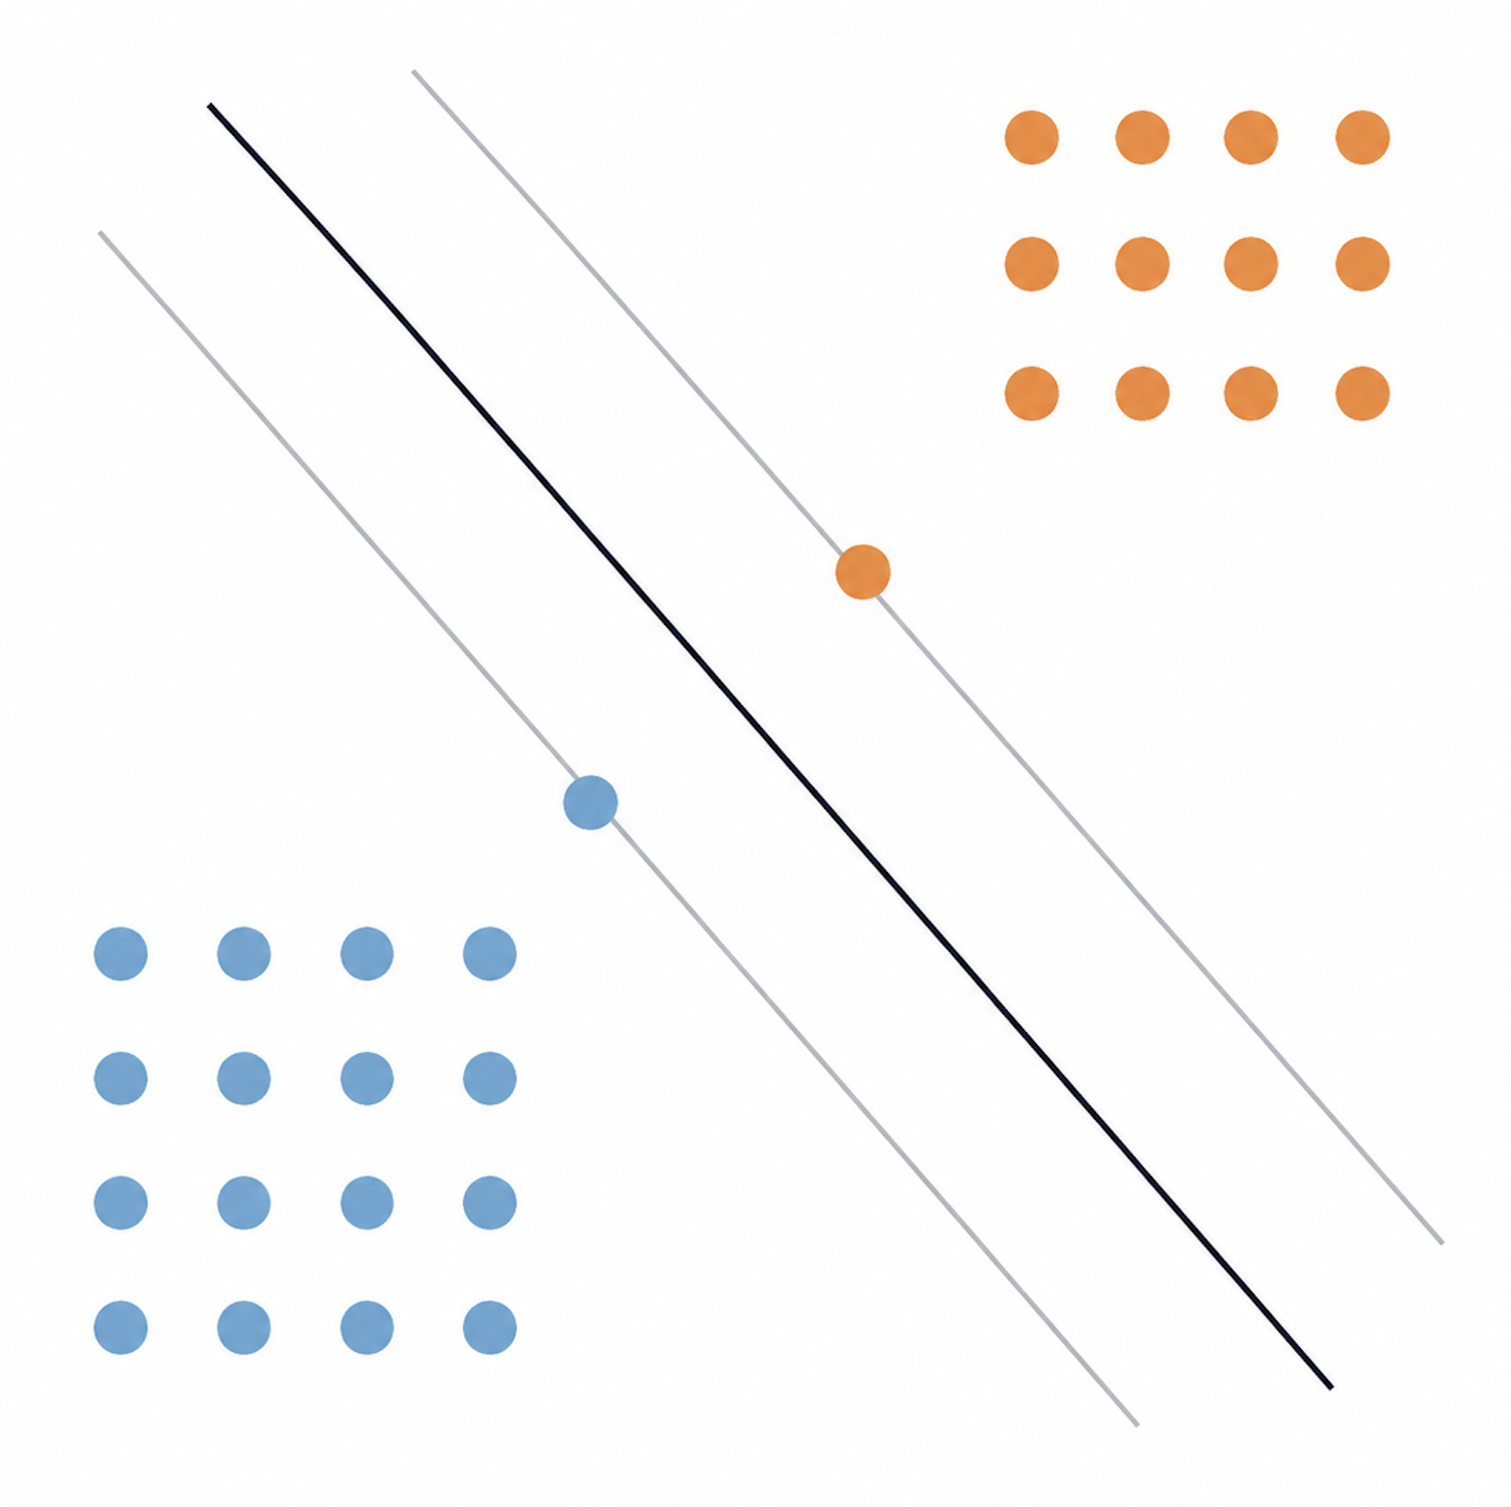
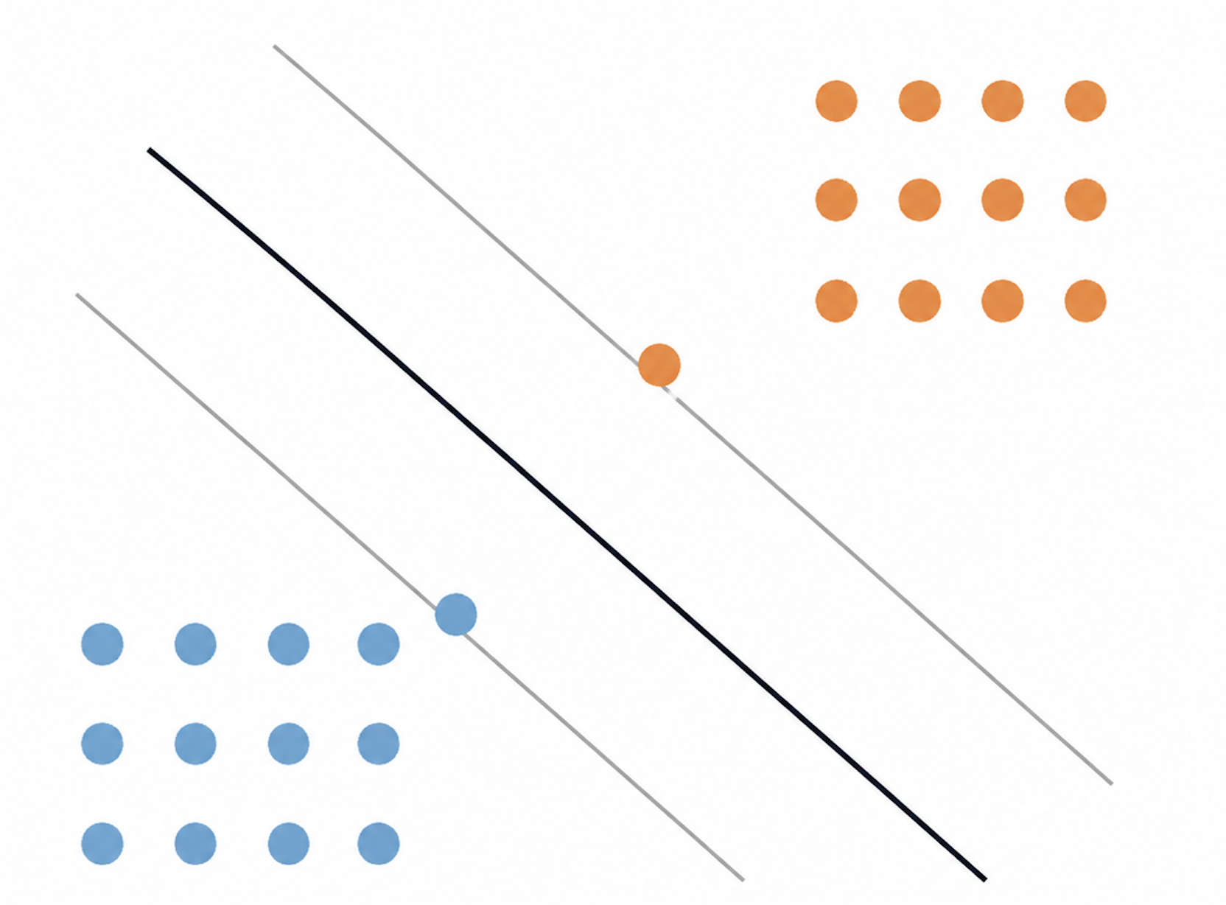
4. Penalty parameter C controls the trade-off
DataSci 224 Final Project
C decides how strongly the model punishes margin violations and misclassification.
Small C: softer penalty
Large C: stronger penalty
C ↑
less tolerant of training errors
wider margin
more tolerance
lower overfit risk
tighter boundary
fewer training errors
higher overfit risk
In this project, C was tuned by cross-validation rather than chosen by hand.
Kathryn Reid
5
Notes:
This is the most important parameter for the soft-margin part of the SVM.
The parameter C controls how strongly the model punishes margin violations and misclassifications.
When C is small, the model is more forgiving. It allows more points to violate the margin, which usually creates a wider margin and a simpler boundary. This may reduce overfitting, but it can also lead to more training errors.
When C is large, the model is less forgiving. It heavily penalizes mistakes, so the classifier tries harder to correctly classify the training data. This can reduce training error, but it may create a tighter boundary that overfits to noise.
So C controls the trade-off between simplicity and fitting the training data closely.
In this project, C should not just be chosen by hand. It is tuned using cross-validation, so the model can choose a value that performs well on unseen data rather than just memorizing the training set.

Slide 6
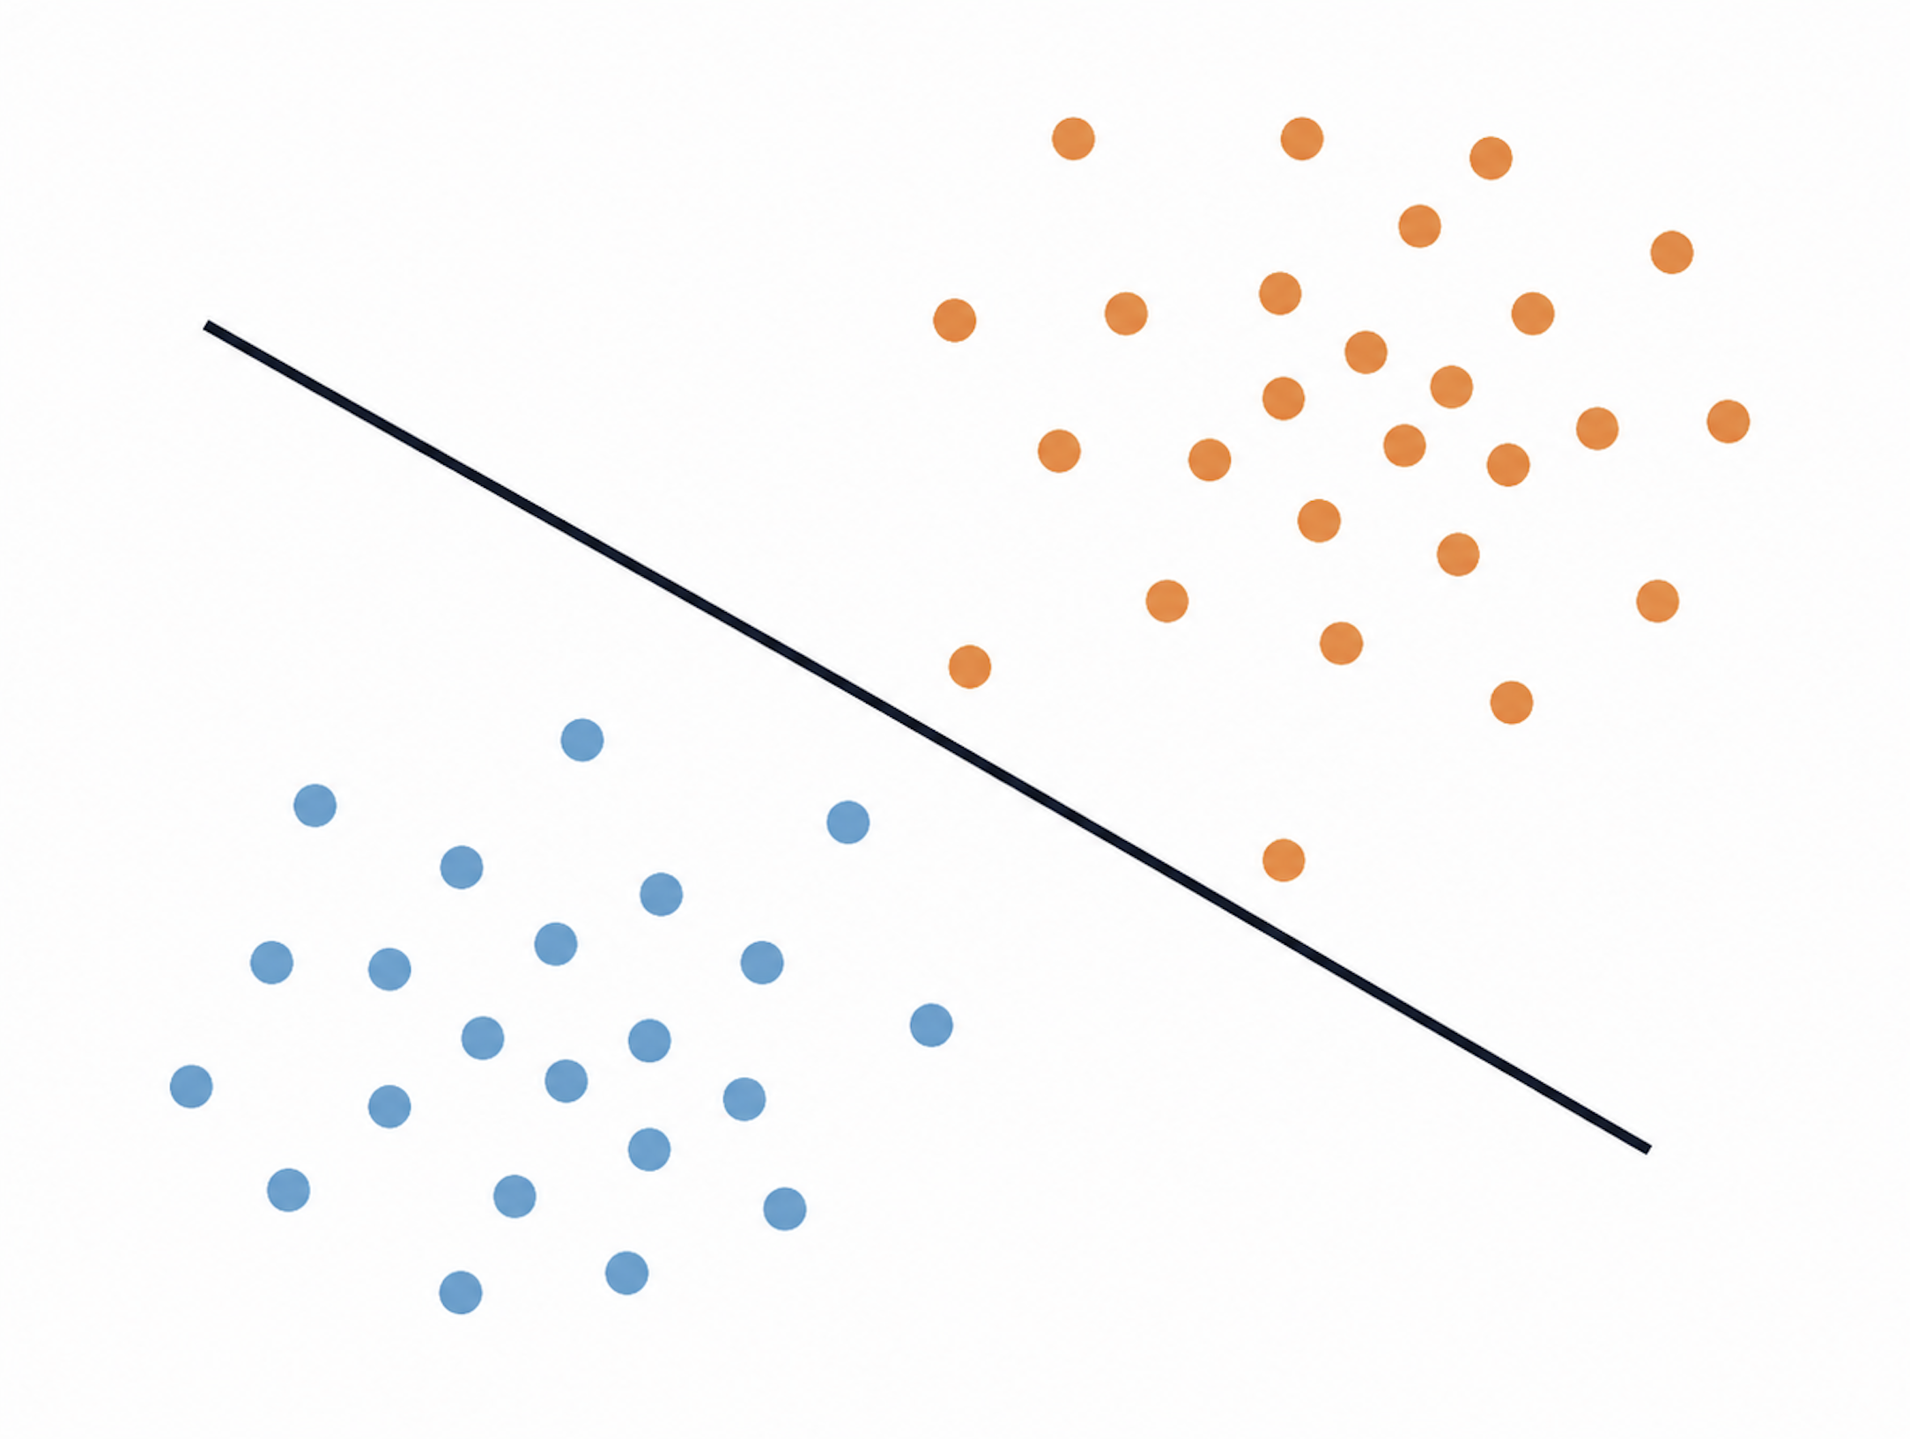
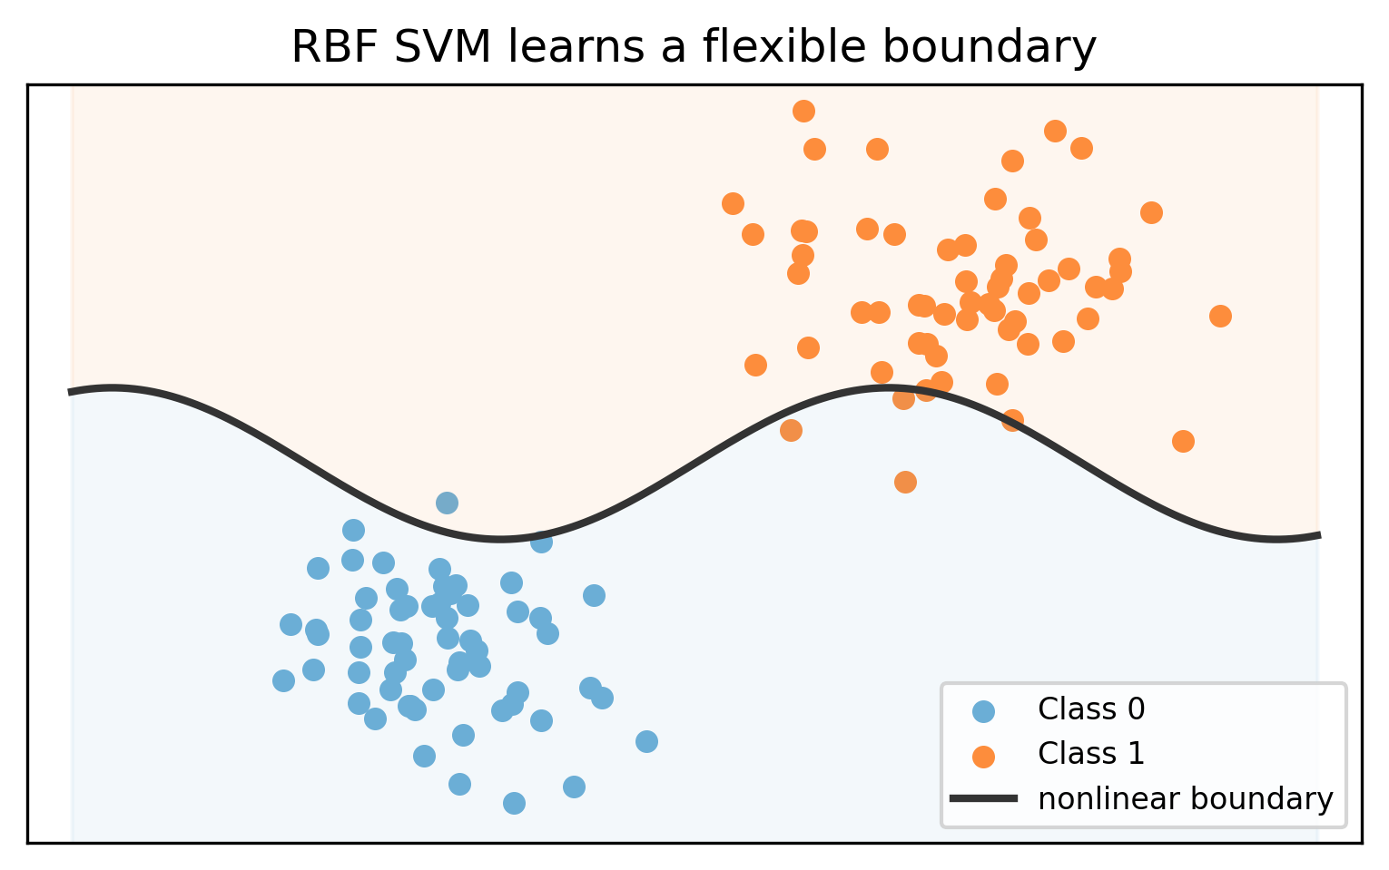
5. Why use the RBF kernel?
DataSci 224 Final Project
The RBF kernel controls the shape of the boundary, but the soft-margin penalty parameter C controls how much the model tolerates mistakes.
Linear SVM
RBF kernel SVM
One straight boundary
K(xᵢ, xⱼ) = exp(-γ ||xᵢ − xⱼ||²)
γ controls how local/flexible the boundary is; C controls the penalty for mistakes.
Kathryn Reid
6
Notes:
The RBF kernel adds another layer to the SVM by allowing a nonlinear decision boundary.
A linear SVM can only draw one straight boundary, which may be too simple if the relationship between voice features and disease status is nonlinear.
The RBF kernel compares how similar observations are to each other. This allows the model to learn a more flexible boundary.
The important distinction is that gamma controls how local or flexible the boundary is, while C controls how strictly the model penalizes mistakes.
So even though this is an RBF kernel SVM, the soft-margin idea is still central. The kernel affects the shape of the boundary, but C controls how much the model tolerates overlap and margin violations.

Slide 7
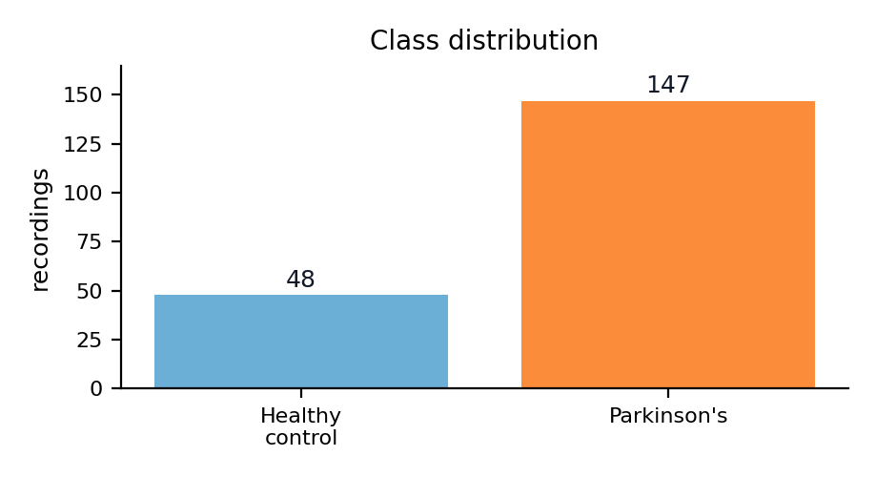
6. Brief application to Parkinson’s voice data
DataSci 224 Final Project
After the tutorial, the dataset is used as a compact example of how the algorithm is applied.
195 recordings
22 voice features
Binary status outcome
no missing values
Imbalanced classes
1
Split data
2
Scale features
3
Fit RBF SVM
4
Tune C + γ
5
Evaluate
Why this is a useful SVM example
Algorithm link
• The groups may overlap in voice-feature space
• The minority healthy-control class needs attention
• C and γ can be tuned rather than chosen by hand
Soft-margin SVM is useful here because it can tolerate overlap while still searching for a stable boundary.
Dataset: Little, M. (2007). Parkinsons. UCI Machine Learning Repository.
Kathryn Reid
7
Notes:
After explaining the algorithm, the Parkinson’s voice dataset is used as a compact example of how this works in practice.
The dataset has 195 recordings, 22 voice features, and a binary status outcome. This makes it useful for an SVM example because the features are continuous, the classes may overlap, and the dataset is not perfectly balanced.
The workflow is: split the data, scale the features, fit an RBF SVM, tune C and gamma, and then evaluate performance.
Scaling is important because SVMs rely on distances between observations, so features need to be on comparable scales.
The key algorithm link is that soft-margin SVMs are useful here because the model does not assume perfect separation. Instead, it can tolerate overlap while still trying to find a stable boundary

Slide 8
7. Evaluating whether the algorithm worked
DataSci 224 Final Project
Because the dataset is imbalanced, accuracy alone would not be enough.
ROC-AUC
Sensitivity
Specificity
F1 score
Overall discrimination
across thresholds
Parkinson’s recordings
correctly identified
Healthy controls
correctly identified
Balance between precision
and recall
Main evaluation questions
Take-home algorithm message
1. Does a nonlinear boundary make sense for these features?
2. Does class weighting reduce majority-class bias?
3. Do C and γ balance simplicity and flexibility?
C controls margin softness; γ controls boundary flexibility.
Final presentation focus: teach the SVM first, then use Parkinson’s voice data as the example application.
Kathryn Reid
8
Notes:
Finally, evaluation matters because accuracy alone may be misleading, especially when classes are imbalanced.
So I would look at metrics such as ROC-AUC, sensitivity, specificity, and F1 score. These help assess whether the model discriminates well overall and whether it performs reasonably for both classes.
The main evaluation questions are whether a nonlinear boundary makes sense, whether class weighting helps reduce majority-class bias, and whether C and gamma balance simplicity with flexibility.
The main take-home message is this: soft-margin SVMs are useful when classes overlap, and the penalty parameter C controls how forgiving or strict the model is about margin violations and misclassification.
So in this presentation, the RBF kernel is the flexible modelling setting, but the core focus is the soft-margin trade-off controlled by C.

